Slide 1
Fair, Accountable, Transparent Machine Learning (FAccT ML) ZG517
Dr. Sugata Ghosal
sugata.ghosal@pilani.bits-pilani.ac.in

Slide 2
Session 7
Time – 10:40 AM to 12:40 PM
These slides are prepared by the instructor, with grateful acknowledgement of many others who made their course materials freely available online.

Slide 3
Fair Visual Representation
Counterfactual Fairness
Counterfactual Face Attribution
Gender Equalized Image Captioning
Adversarial Removal of Gender Features

Slide 4
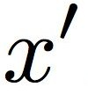
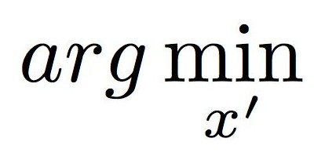
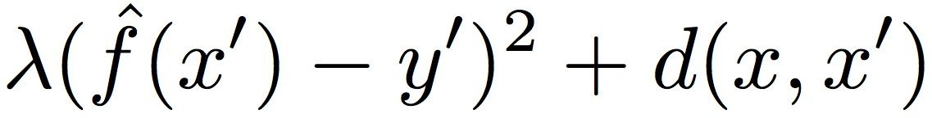


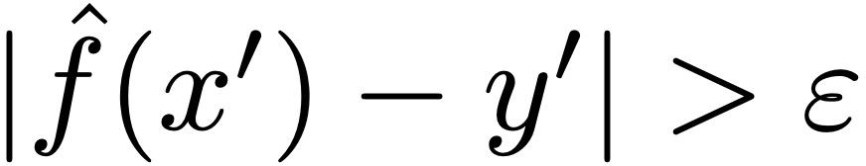
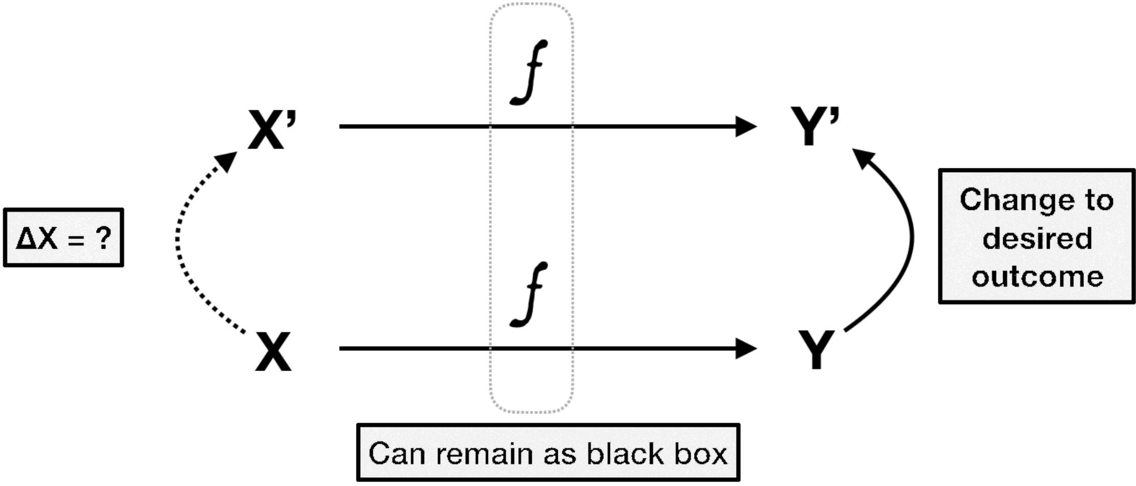
Counterfactual Explanation
counterfactual example
desired outcome
distance function
Increase
while
Grath et al, 2018

Slide 5
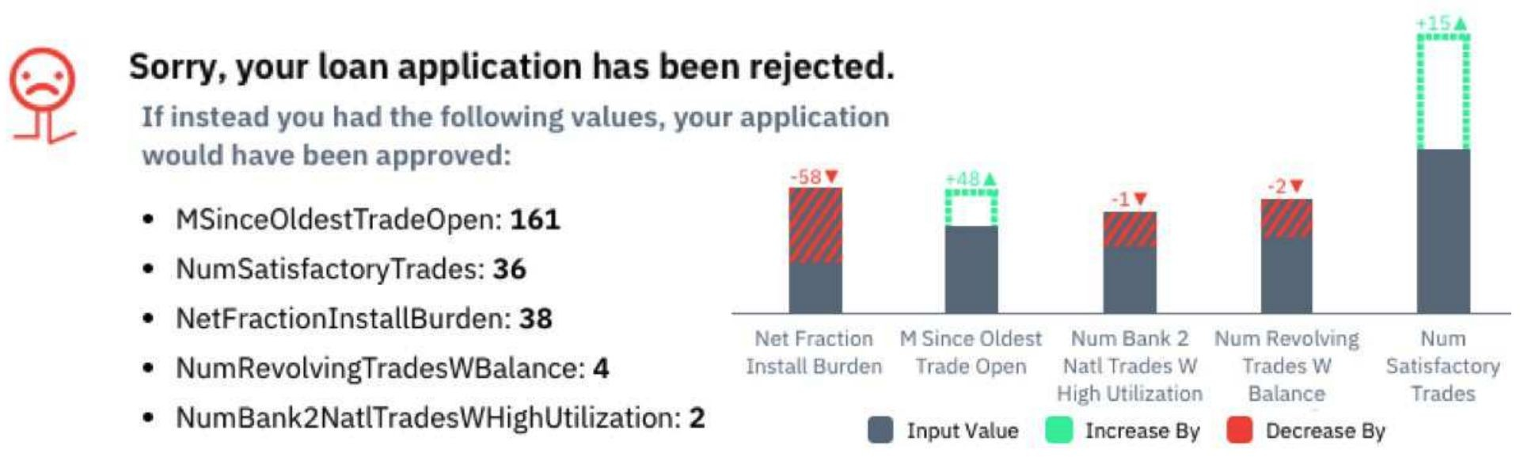
Counterfactual Explanations
Grath et al, 2018

Slide 6
Counterfactual Fairness
X'
A=1
Y
X
A Y
A=2
A=3
Real Examples
Counterfactual Examples
Real Examples
Counterfactual Examples
Kusner et al, 2017

Slide 7
Causal View of Counterfactual Fairness
U
X
Real Examples
A=a
Y
Real Examples
Counterfactual Examples
Kusner et al, 2017

Slide 8
Causal View of Counterfactual Fairness
U
recover
X
Real Examples
A=a
Y
X' A←a'
Counterfactual Examples
Y
Real Examples
Counterfactual Examples
Kusner et al, 2017

Slide 9
Red Car Problem
Develop a Fair Algorithm to Determine Insurance Premium
no accident
future accidents
color of the car
red
other
Group 1
Group 2
Group 3
P(y = acc | A =1) =0.2
P(y = acc | A =2) =0.2
P(y = acc | A =3) =0.2
Kusner et al, 2017

Slide 10


Causal Perspective of the Red Car Problem
Group
A
U
Aggressive Driving
U
Drive Red Cars
X
Y
Accident Rates
Y
X
A=a
X'
A=a'
Observed Variables
Latent (Unobserved) Variables
Kusner et al, 2017

Slide 11
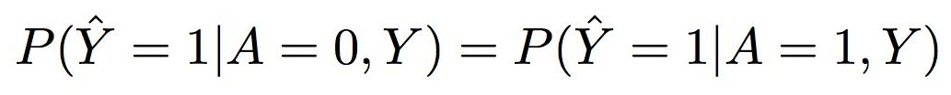
Fairness Criteria
Individual Treatment | Group Treatment
Fairness Through Unawareness Excludes Sensitive Information A from the predictor | Demographic Parity
Individual Fairness | Equal Opportunity/Odds
Counterfactual Fairness

Slide 12
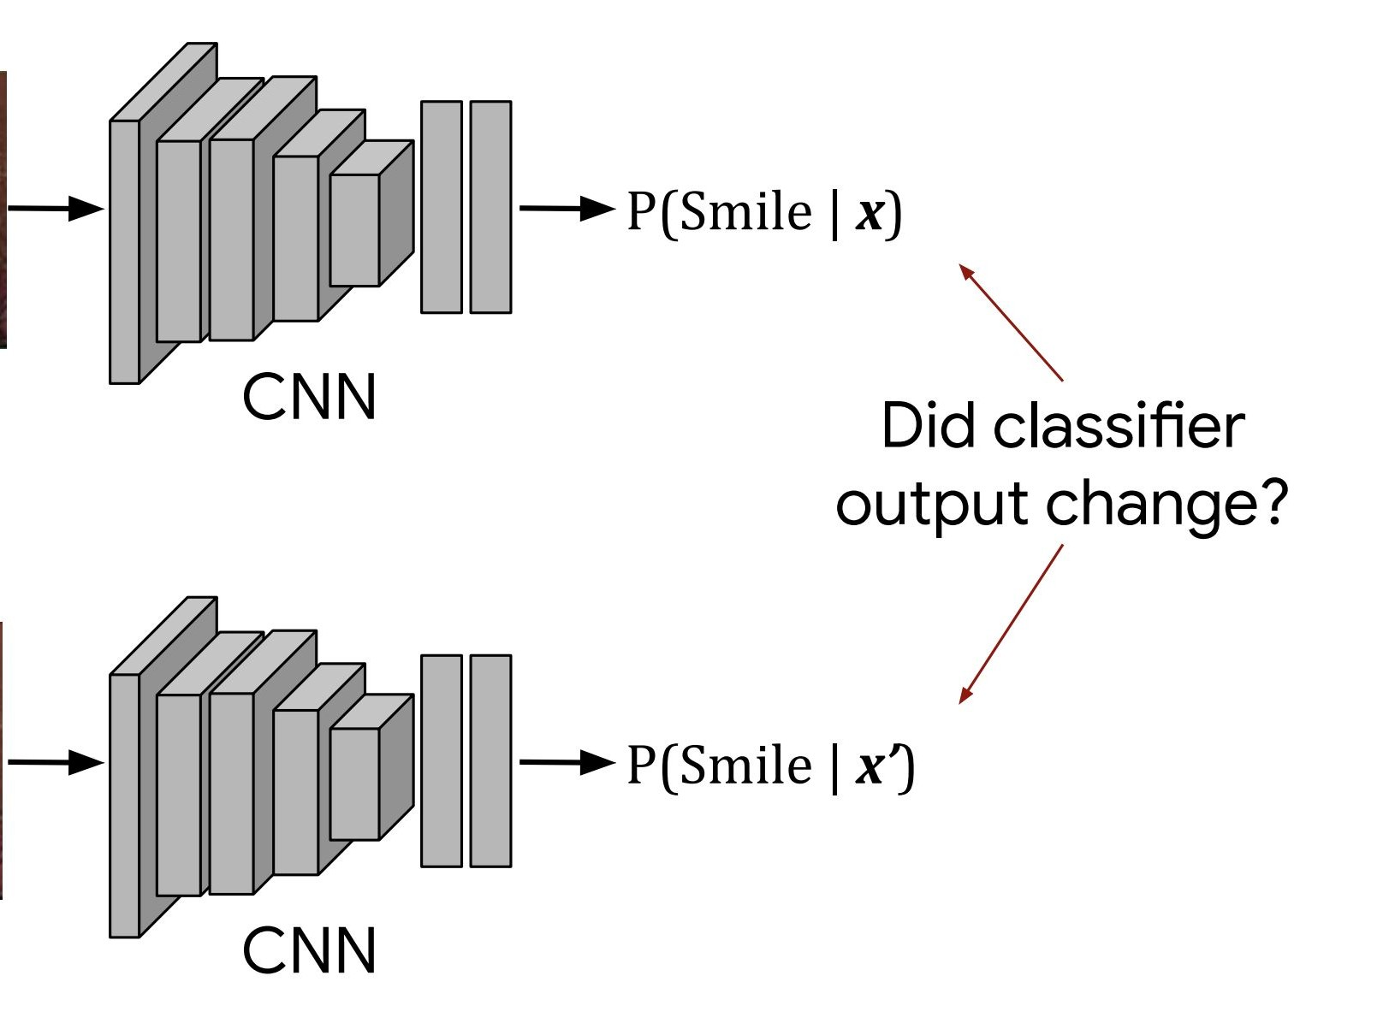
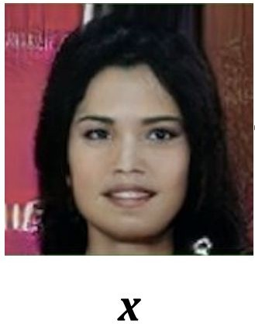
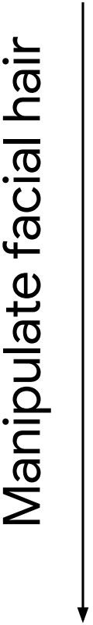
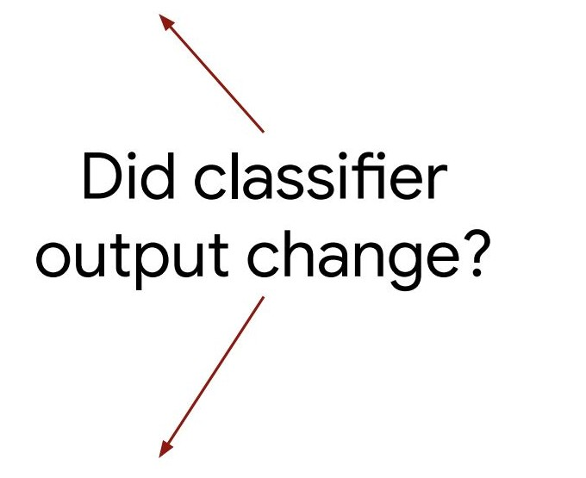
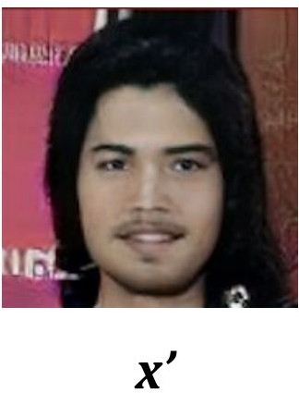
Counterfactual Face Attribution
Evaluate the Counterfactual Fairness of Face Recognition Systems
z
z'

Slide 13
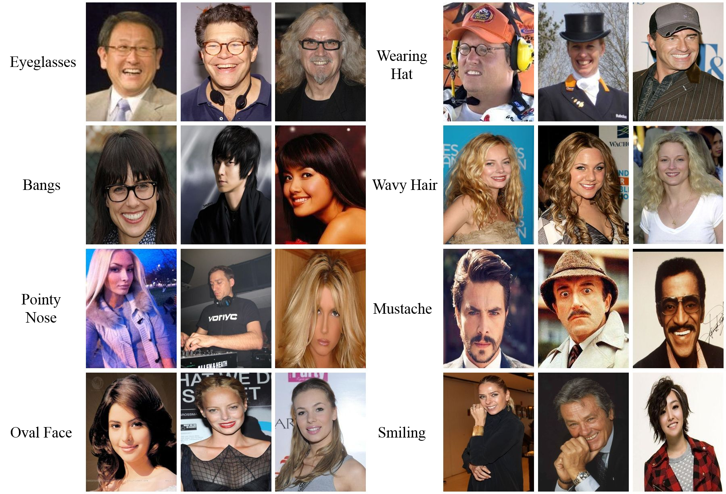
CelebA Dataset
Liu et al, 2015

Slide 14
Model Architecture
z ~ p(z)
z = E(x)
x ~ G(z)
x
 | y = f(x)
z
D(z)
real?
smile?
f(x) - smile classifier G(z) - generator
D(z) - discriminator E (x) - encoder
Denton et al, 2019

Slide 15
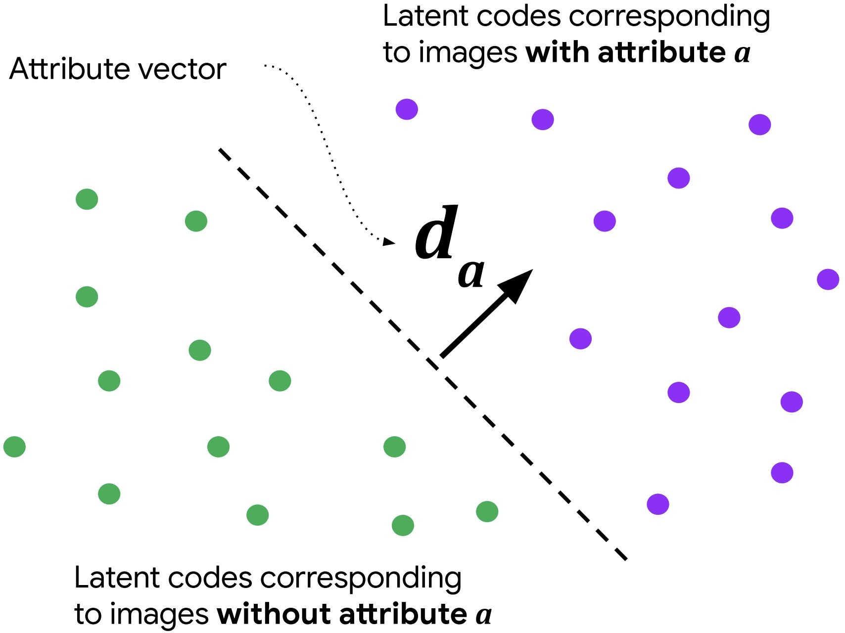
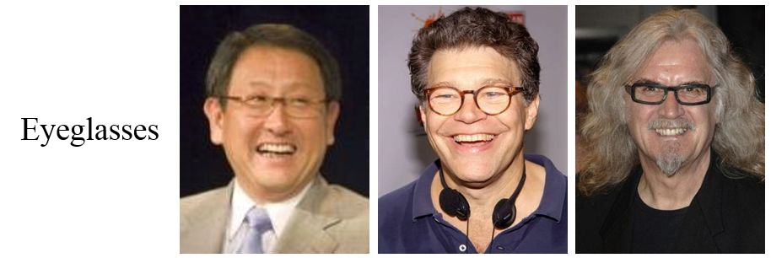
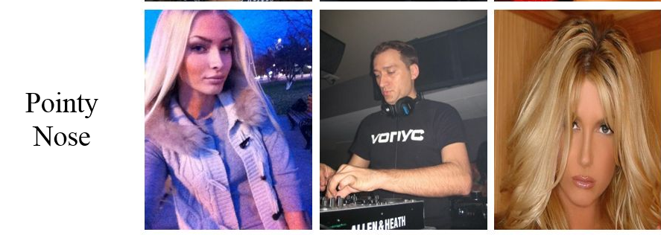
Latent Code Attribution
latent code z

Slide 16
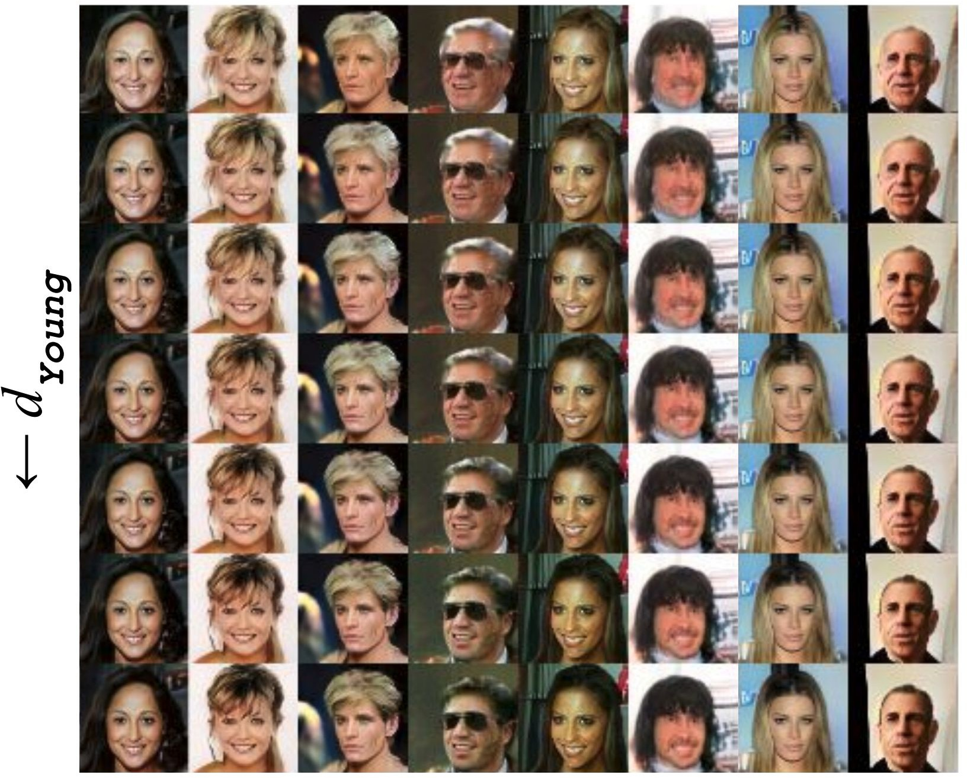
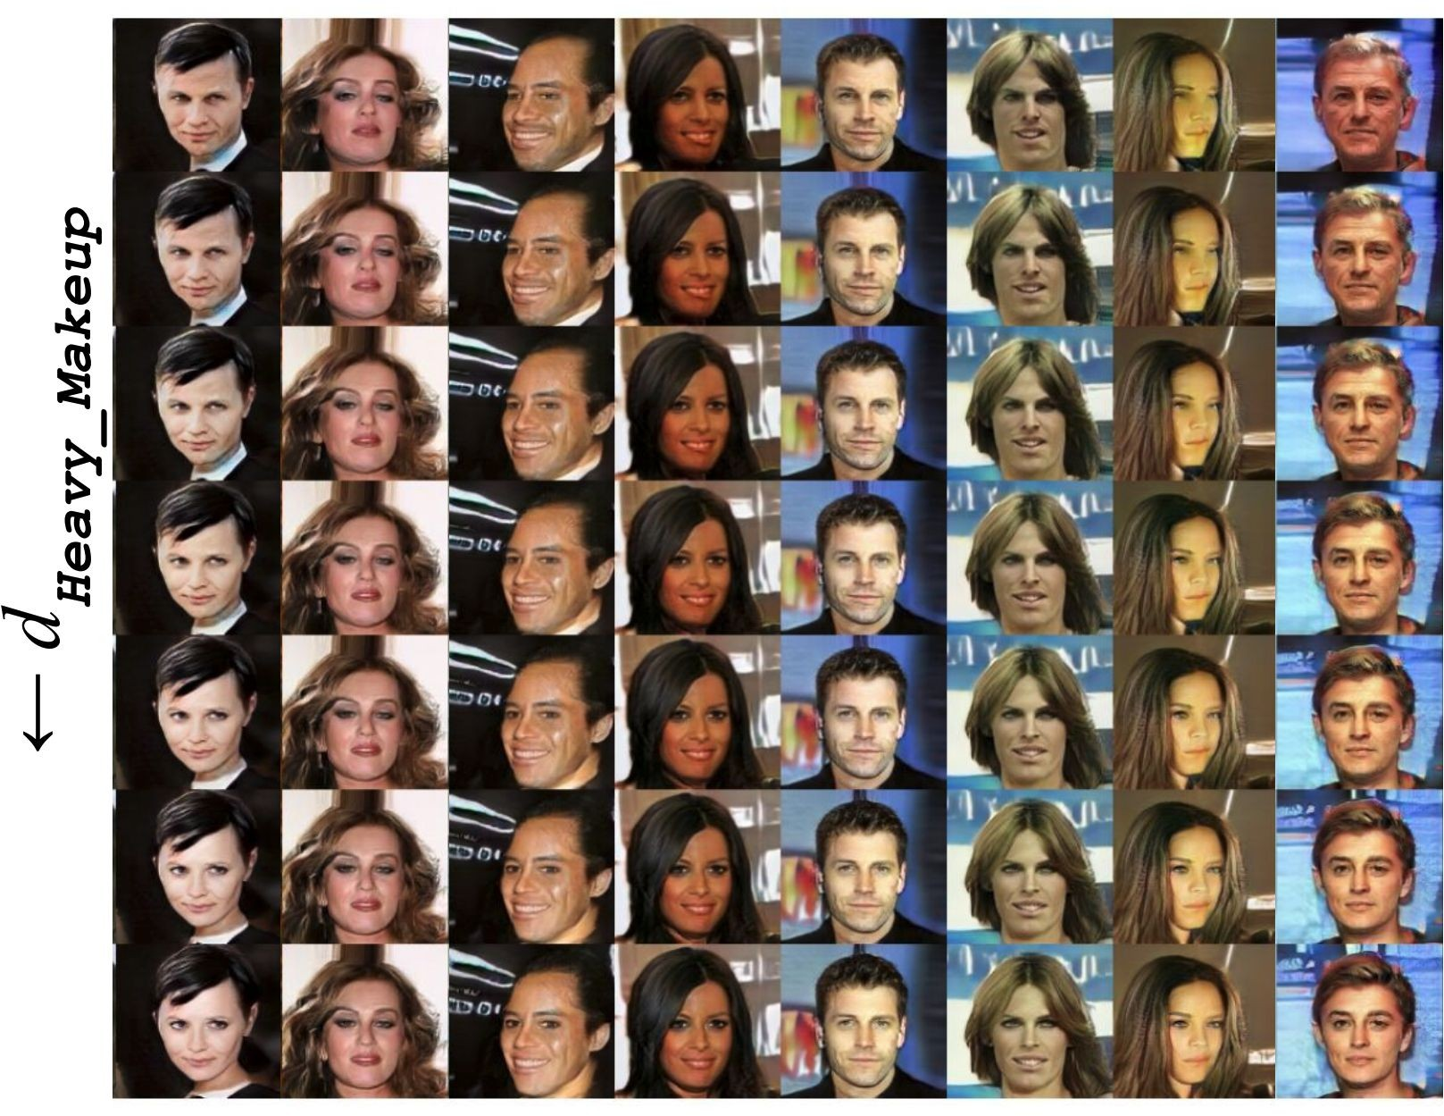
Latent Code Manipulation
Denton et al, 2019

Slide 17
Counterfactual Fairness Assessment
A ← a'
z'
 | x~ G(z)
z
 | z=E(x)
x
 | y=f(x)
x'
 | y'=f(x')
changed?
smile?
smile?
Denton et al, 2019

Slide 18
Sensitivity
x
z
z'
x'
A←a
A←a'
f(x) - smile classifier G(z) - generator D(z) - discriminator

Slide 19
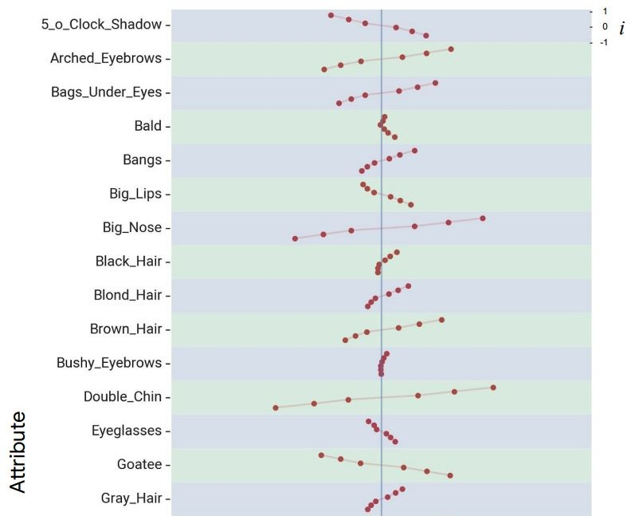
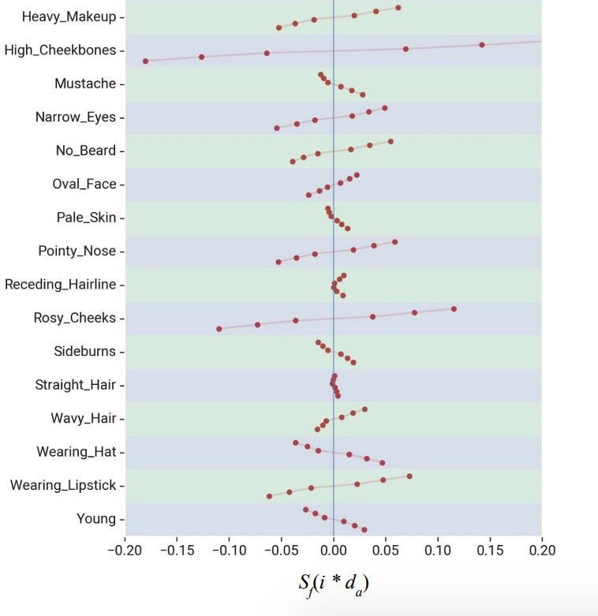
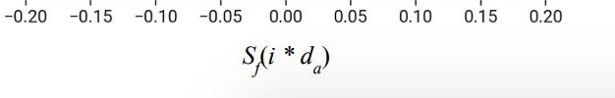
Sensitivity Results

Slide 20
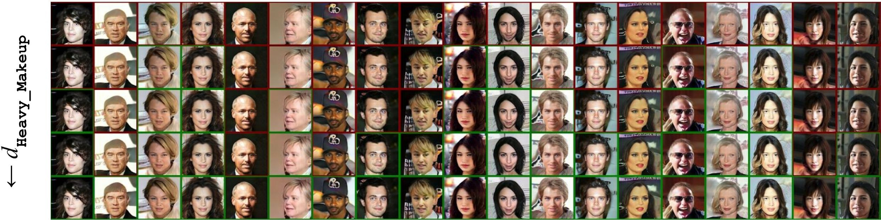
Heavy Makeup

Slide 21
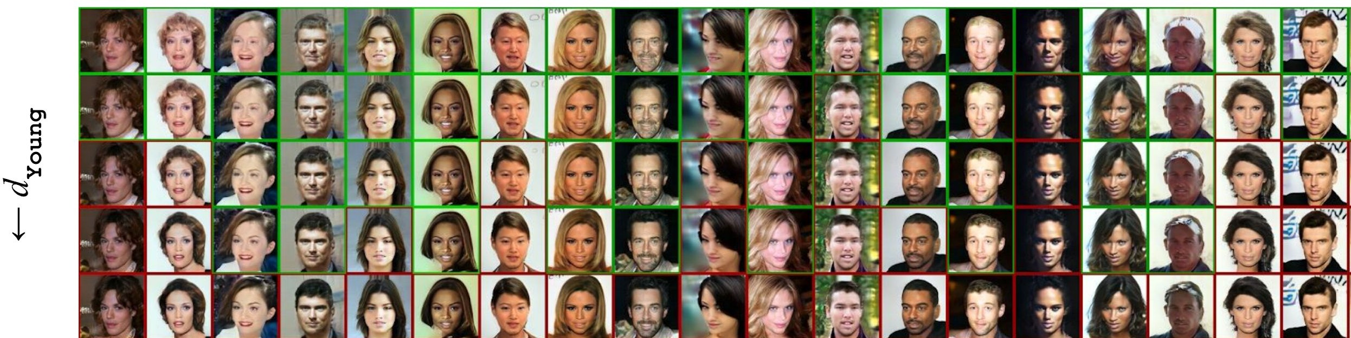
Young

Slide 22
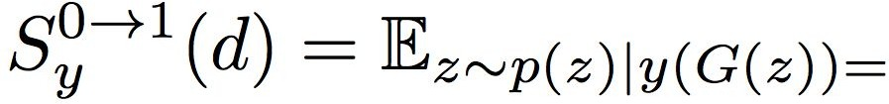


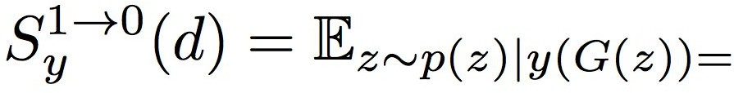
Directional Sensitivity
from "not smiling" to "smiling"
from "smiling" to "not smiling"

Slide 23
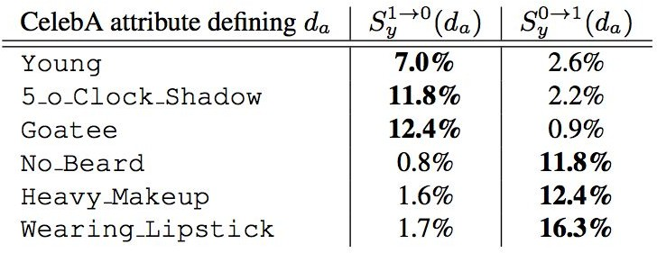
Sensitivity Results

Slide 24
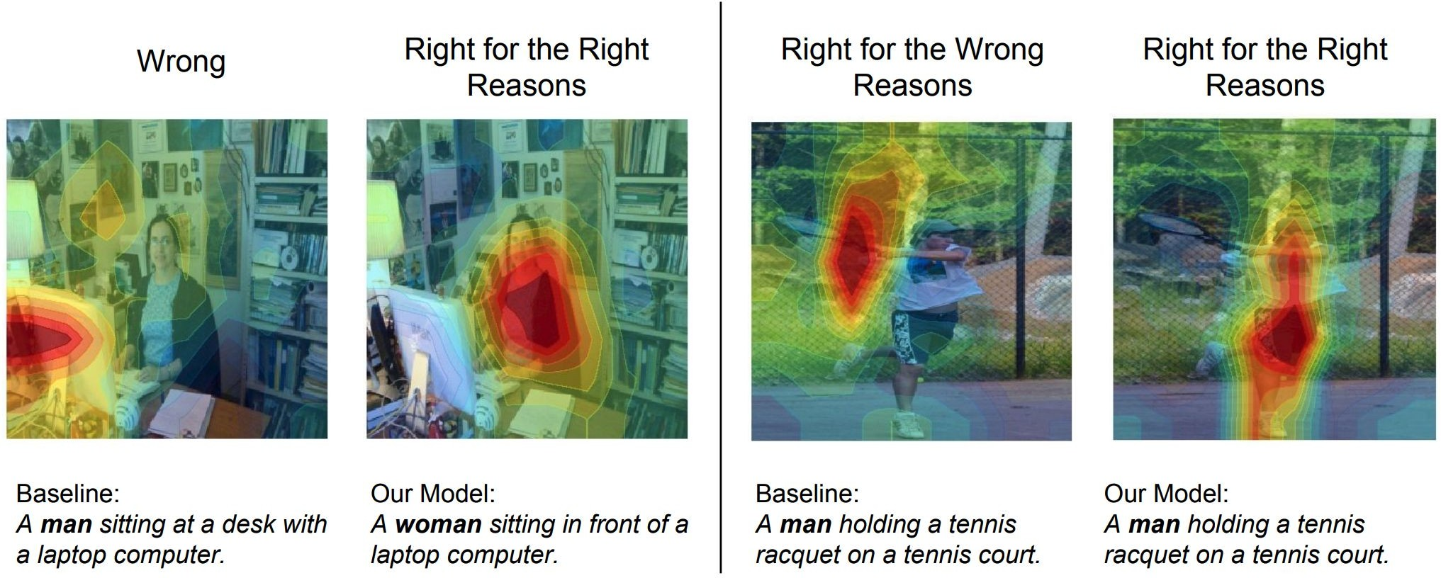
The Equalizer Model
Burns et al, 2019

Slide 25
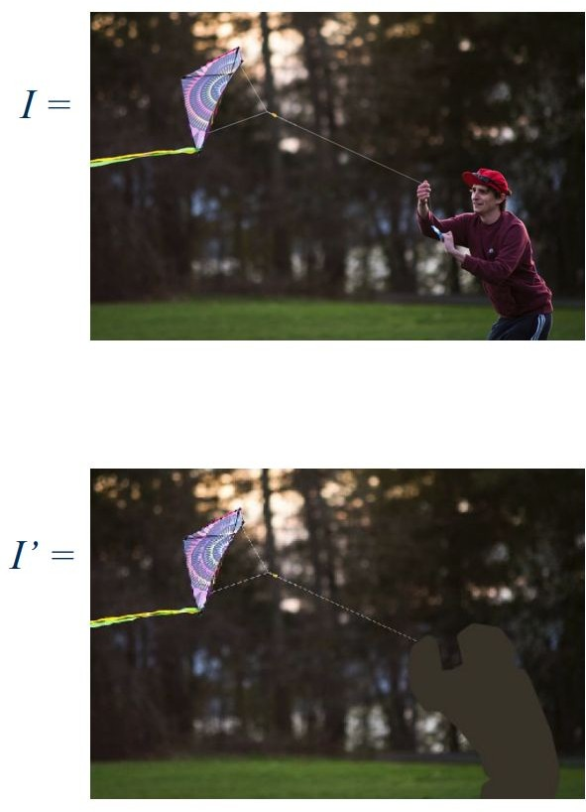
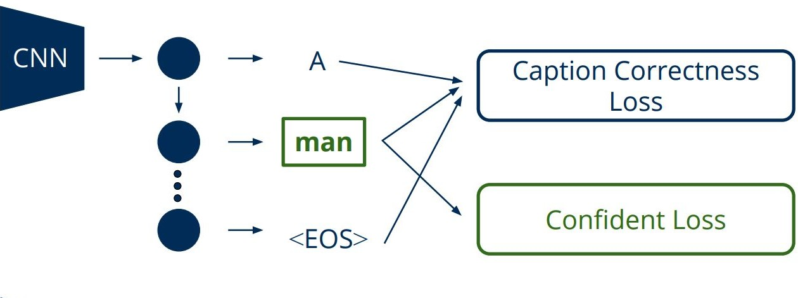
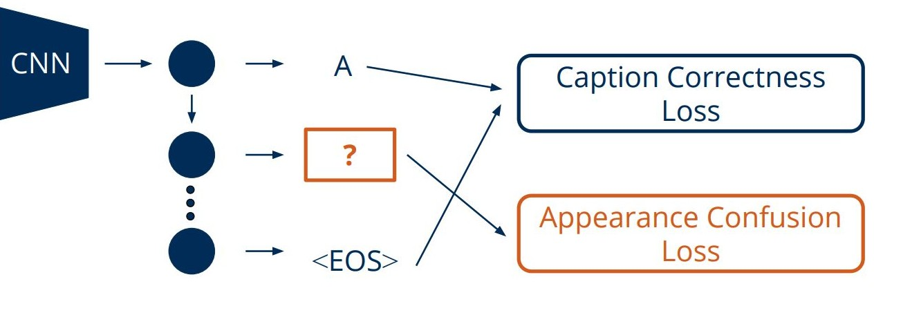
The Basic Idea
Original Image
Annotated Gender Neutral Image
Burns et al, 2019

Slide 26
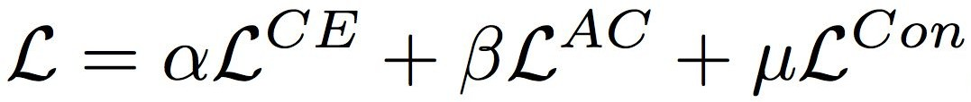
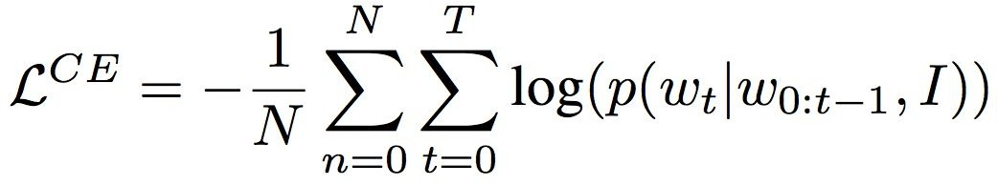
The Equalizer Model
Cross Entropy Loss
Appearance Confusing Loss on the gender neutral image
Confidence Loss on the original image
Burns et al, 2019

Slide 27
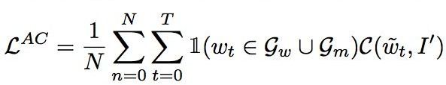
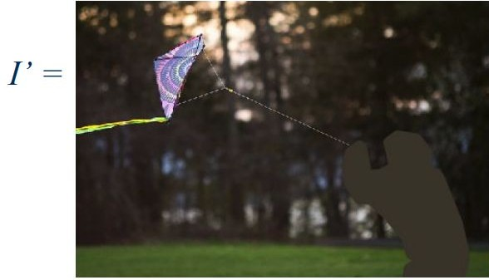




Appearance Confusing Objective
Push Toward Extremes
set of words for woman
set of words for man
Burns et al, 2019

Slide 28
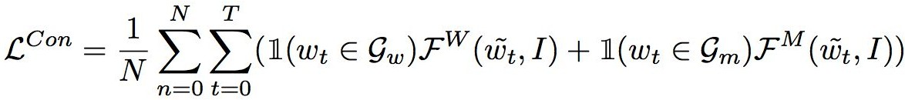
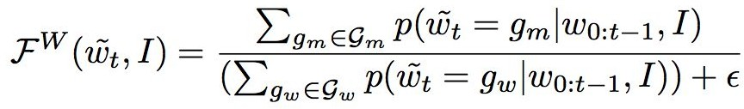
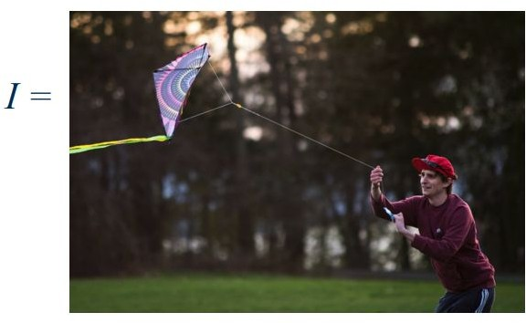

Confidence Objective
set of words for woman
set of words for man
Burns et al, 2019

Slide 29
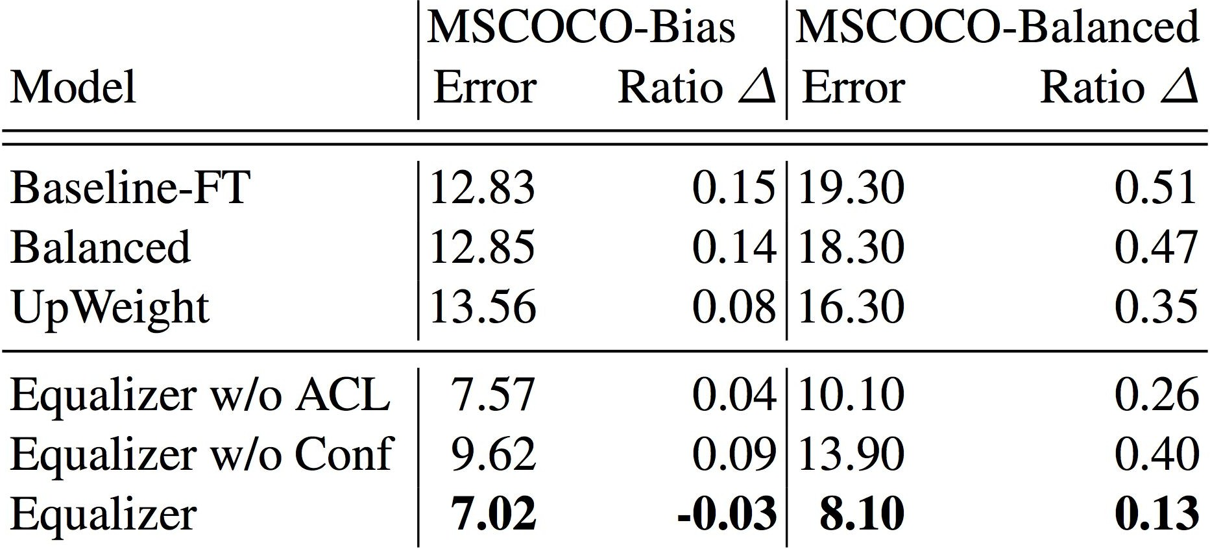

Results
Baseline-FT - basic LSTM attention model (Xu et al, 2015) Balanced - resampled dataset to have balanced gender ratio UpWeight - reweighting
- change to the gender ratio compared to the dataset
Burns et al, 2019

Slide 30
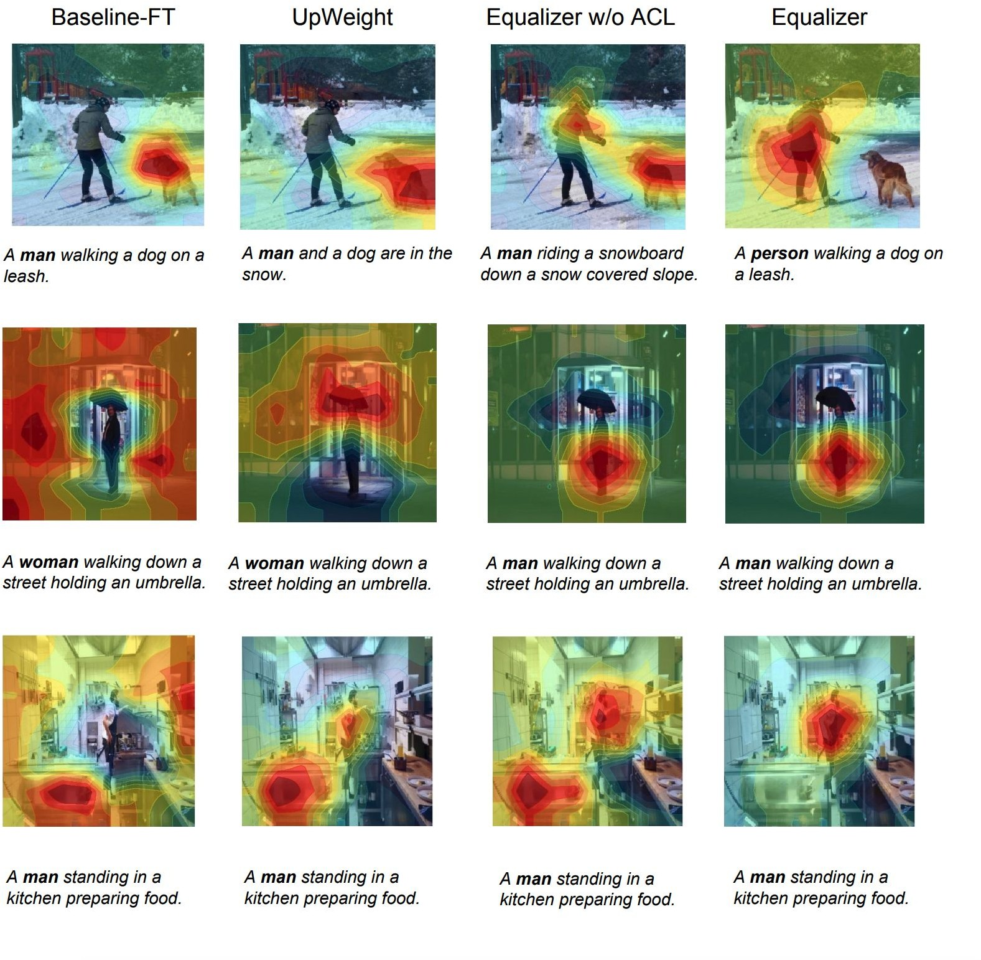
Results

Slide 31
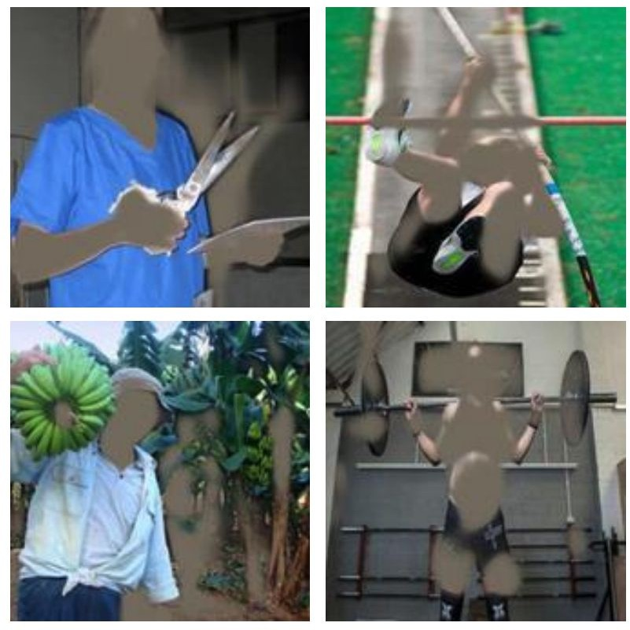
Adversarial Removal of Gender Features
Wang et al, 2019

Slide 32


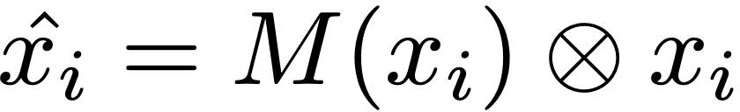

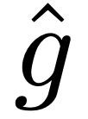
Model Architecture
M
Feature Mask
Gender Removed Sample
h
Representation
Reconstruction Loss
Task Loss
Adversarial Loss
Wang et al, 2019
Task Predictions
Gender Predictions

Slide 33
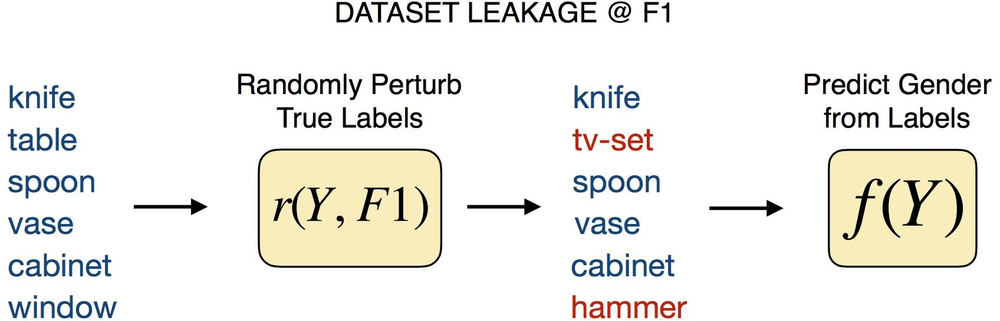
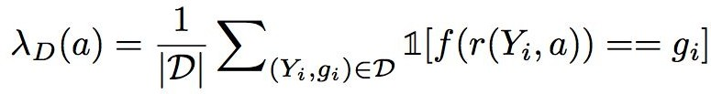
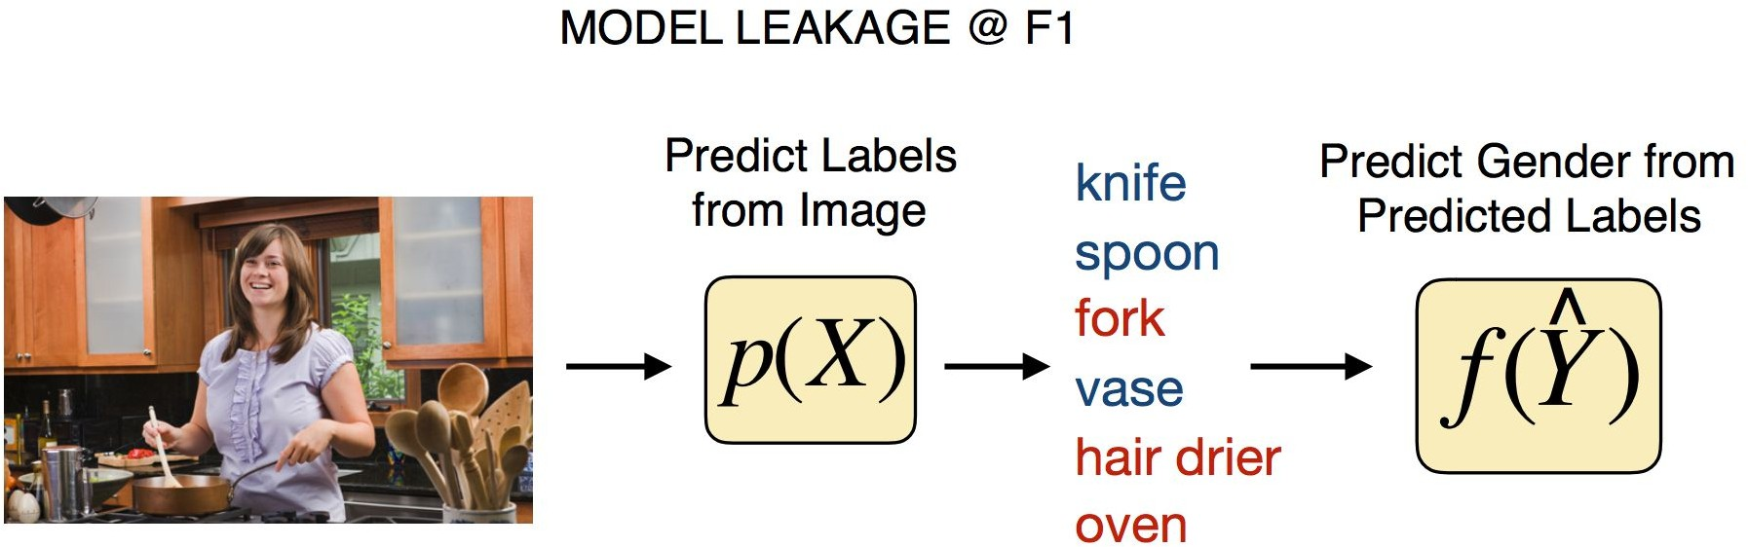

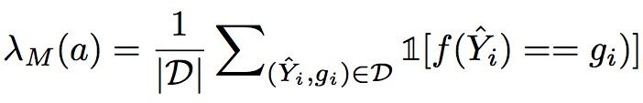
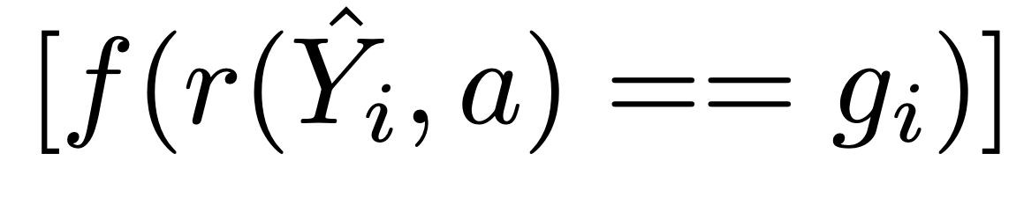
Evaluate Sensitive Information Leakage
Train an attacker f(y) that reverse engineer the gender information
Data Resampling
Bias Amplification
Wang et al, 2019

Slide 34
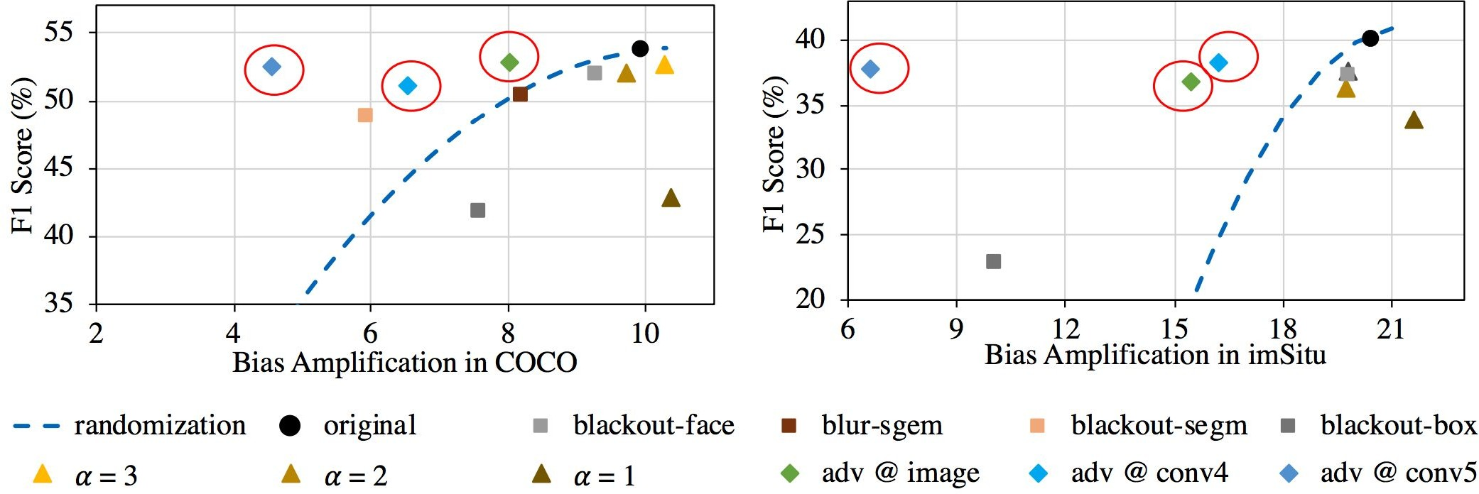
Accuracy and Bias Results
original - no debiasing mask random - adding random noise
blackout-face - black out using a face detector
blur-sgem - black out using ground truth segmentation blackout-box - blackout using bounding boxes
Wang et al, 2019

Slide 35
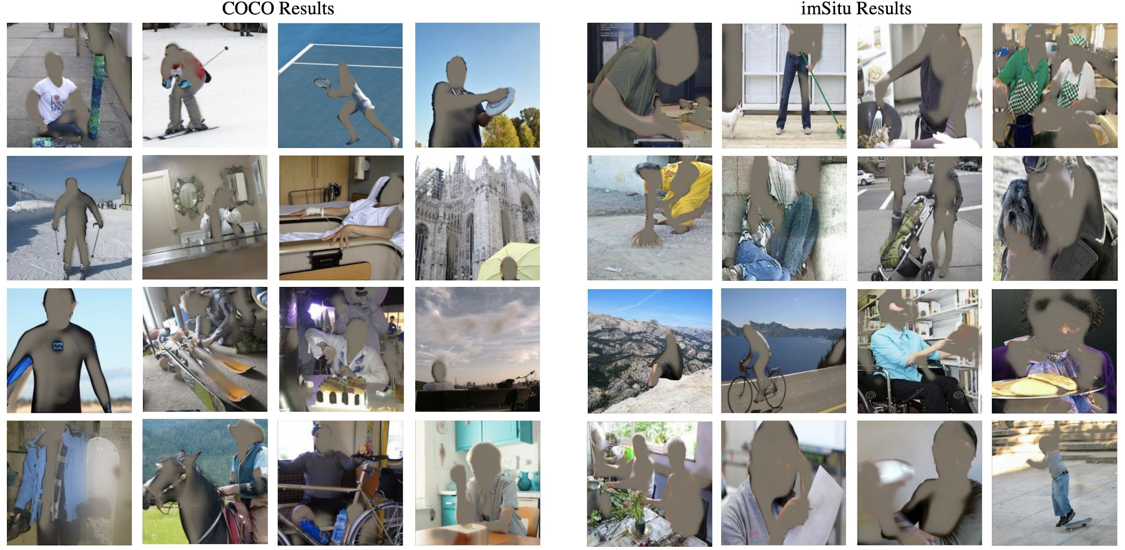
Qualitative Results
Wang et al, 2019

Slide 36
Summary
Fair Machine Learning
Prevents ML models from biasing toward specific groups when allocating favorable outcomes
Group Treatments of Fairness
Demographic Parity
Equalized Odds/Opportunity
Individual Treatments of Fairness
Fairness Through Awareness Individual Fairness
Individual Fairness
Counterfactual Fairness
Fair ML Techniques
Pre-processing Methods: Resampling, Reweighting, Optimized-preprocessing
In-processing Methods: Regularization, Adversarial Learning
Post-processing Methods: Learning to Defer

Slide 37
Summary
Fair NLP Methods
Debiasing Word Embeddings
Data Augmentation
Gender Swapping
Fair Representation for Pre-trained Encoders
Fair Visual Representations
Counterfactual Face Attribution
Gender Equalized Image Captioning
Adversarial Removal of Gender Features

